Slide 1
Chapter 1
Introduction to web development

Slide 2
Objectives
Describe the components of a web application.
Distinguish between the Internet and an intranet.
Describe HTTP requests and responses.
Distinguish between the way a web server processes static web pages and dynamic web pages.
Name the five major web browsers.
Describe the use of JavaScript.
Distinguish between HTML and CSS.
Explain how you deploy a website on the Internet.
Describe the components of an HTTP URL.
Describe these five web development issues: usability, cross-browser compatibility, user accessibility, search engine optimization, and Responsive Web Design.

Slide 3
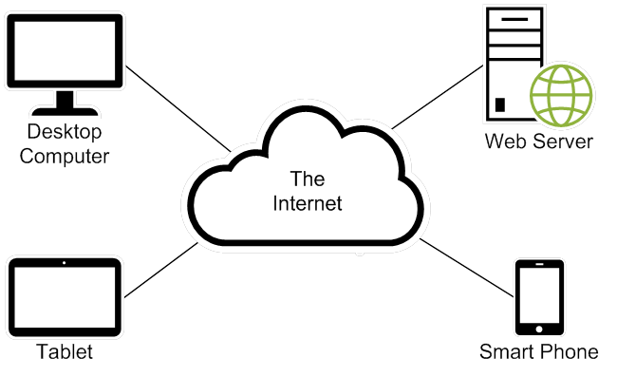
The components of a web application

Slide 4
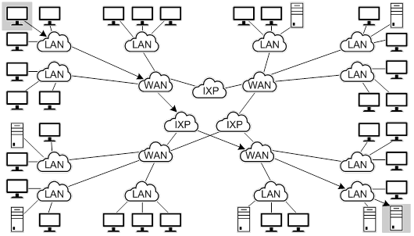
The architecture of the Internet
IXP – Internet exchange point: physical infrastructure

Slide 5
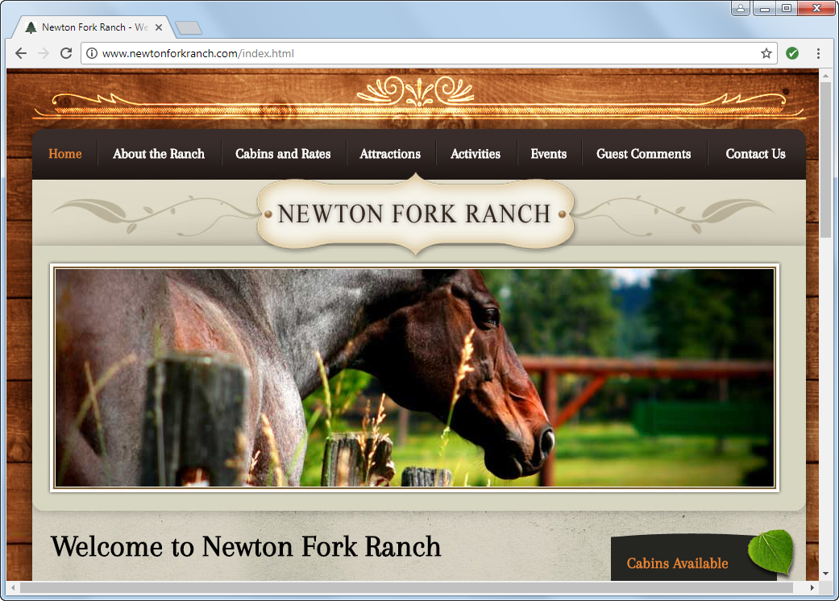
A static web page

Slide 6
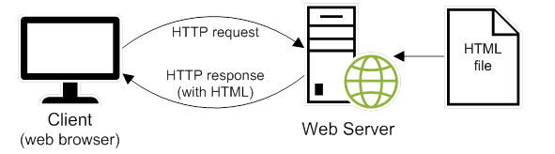
How a web server processes a static web page

Slide 7
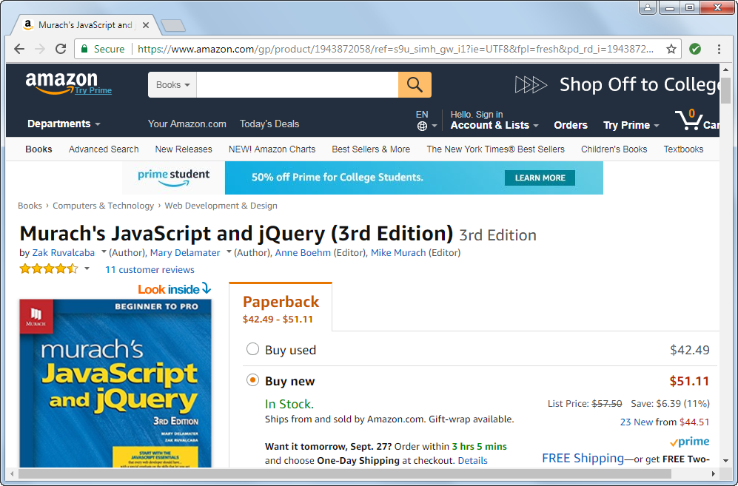
A dynamic web page at amazon.com

Slide 8
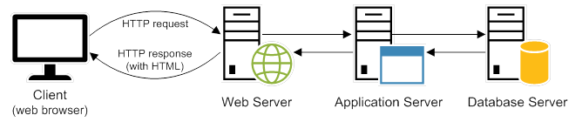
How a web server processes a dynamic web page
Server-side scripting languages
C# and Visual Basic
Java
PHP
Ruby
Perl
Python

Slide 9
Web browsers
Chrome
Firefox
Edge
Internet Explorer
Safari
Opera

Slide 10
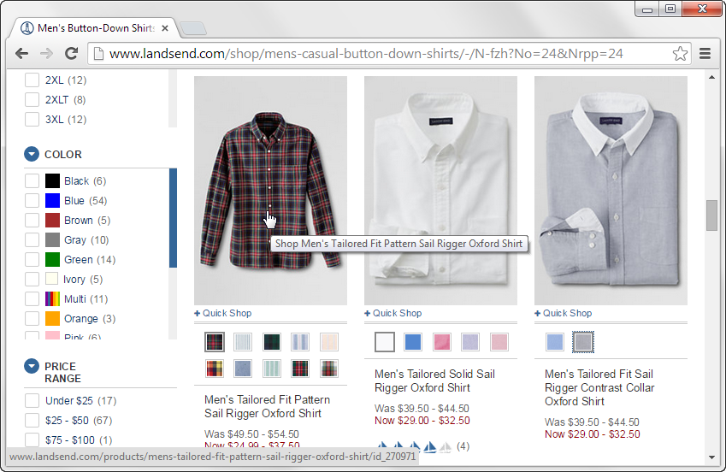
A web page with image swaps and rollovers

Slide 11
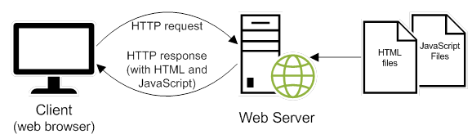
How JavaScript fits into this architecture
Three of the common uses of JavaScript
Data validation
Image swaps and rollovers
Accordion widget: A graphical control element comprising a vertically stacked list of items, such as labels or thumbnails. Each item can be "expanded" or "stretched" to reveal the content associated with that item.

Slide 12
The code for an HTML file
<!doctype html>
<html lang="en">
<head>
<meta charset="utf-8">
<title>JavaScript and jQuery book</title>
</head>
<body>
<h1>JavaScript and jQuery (3rd Edition)</h1>
<img src="javascript_jquery.jpg" alt="JavaScript and jQuery Book">
<p>Today, ... does best.</p>
<p>Now, ... <a href="">read more...</a></p>
</body>
</html>

Slide 13
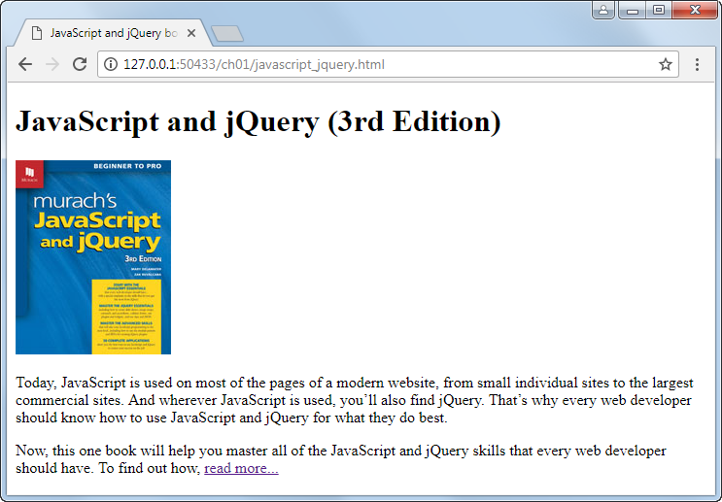
The HTML displayed in a web browser

Slide 14
The link element for a CSS file
<link rel="stylesheet" href="book.css">

Slide 15
The code for the CSS file named book.css
body {
font-family: Arial, Helvetica, sans-serif;
font-size: 100%;
width: 550px;
margin: 0 auto;
padding: 1em;
border: 1px solid navy;
}
h1 {
margin: 0;
padding: .25em;
font-size: 200%;
color: navy;
}
img {
float: left;
margin: 0 1em 1 em 1em; }
p {
margin: 0;
padding-bottom: .5em; }

Slide 16
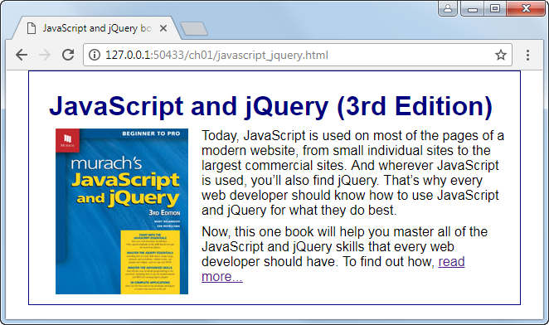
The web page displayed in a web browser

Slide 17
Two websites to become familiar with
World Wide Web Consortium (W3C): www.w3.org
Web Hypertext Application Technology Working Group (WHATWG): www.whatwg.org
W3School: https://www.w3schools.com/

Slide 18
Five free text editors
Notepad ++
Brackets
Atom
Visual Studio Code
TextMate

Slide 19
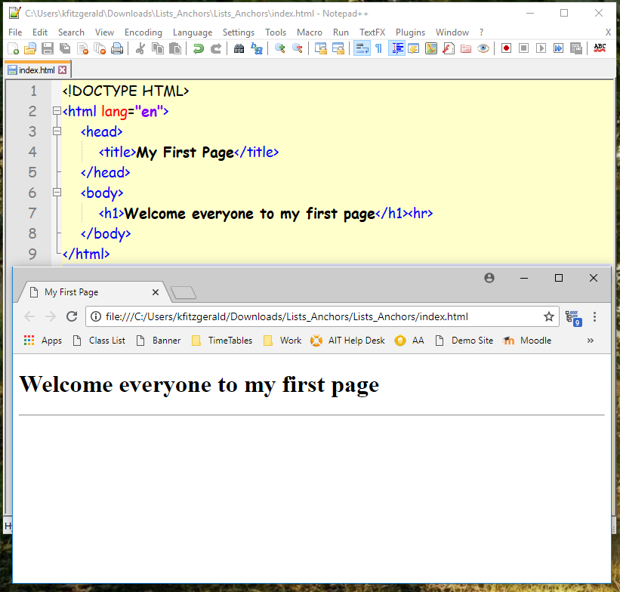

Slide 20
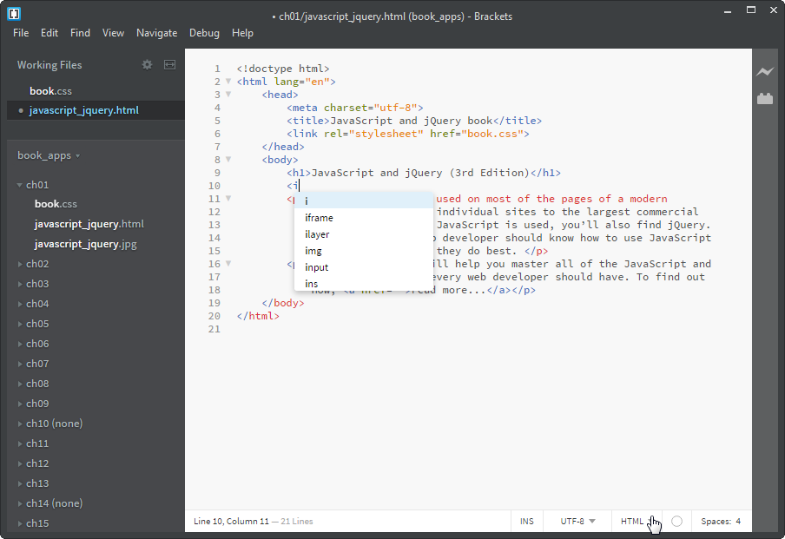
Brackets and its auto-completion feature

Slide 21
Popular IDEs for web development
Adobe Dreamweaver CC
Microsoft Visual Studio
WebStorm
Eclipse
NetBeans
Aptana Studio 3
Cloud9

Slide 22
Some popular FTP programs
FileZilla
FTP Voyager
CuteFTP
Fetch

Slide 23
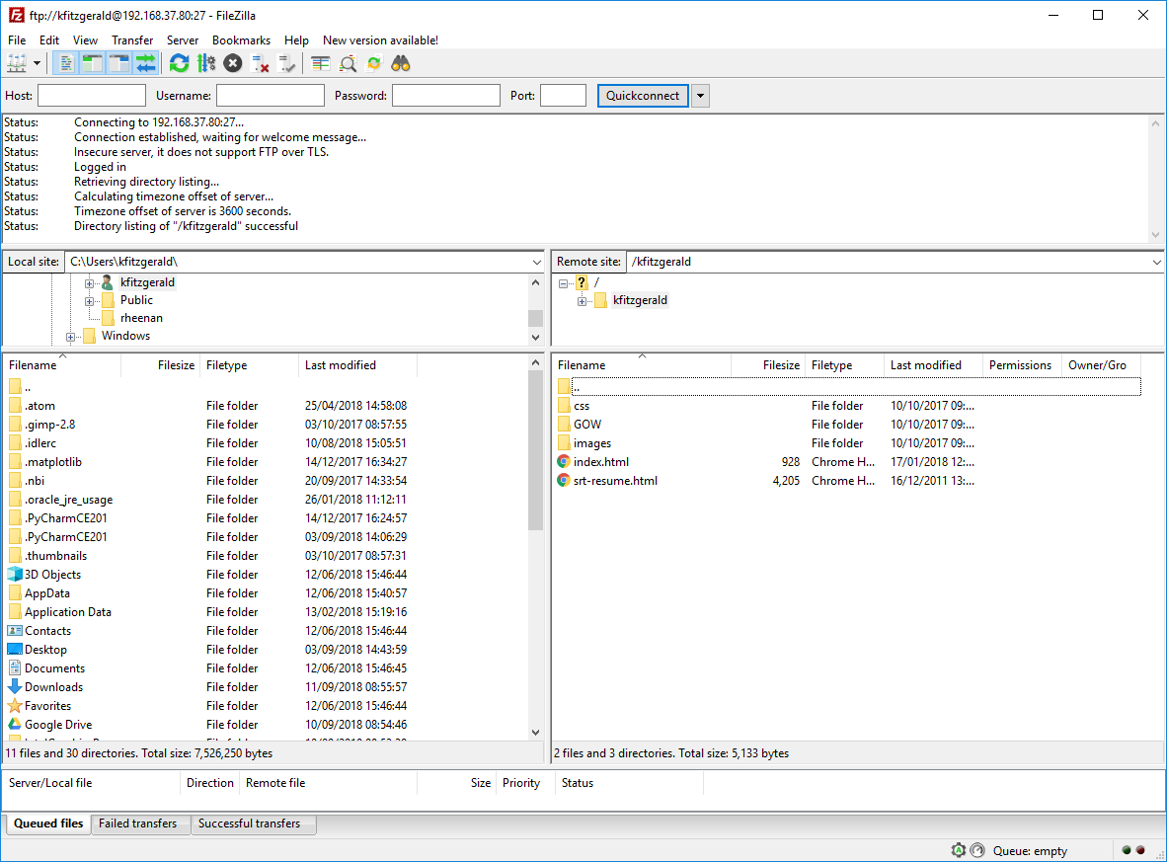
The first page to load must be named index.html

Slide 24

The components of an HTTP URL
What happens if you omit parts of a URL
If you omit the protocol, the default of http:// will be used.
If you omit the filename, the default document name for the web server will be used.
Two ways to access a web page on the Internet
Enter the URL of a web page into the browser’s address bar.
Click on a link in the current web page to load the next web page.

Slide 25
Naming recommendations for folders and files
Create names for folders and files that consist of lowercase letters, numbers, underscores or hyphens, and the period.
Use filenames that clearly indicate what a page contains. This is good for search engine optimization.

Slide 26
How to view the source code for a web page
In Chrome, right-click the page and select the View Page Source command.
In Internet Explorer or Edge, right-click the page and select the View Source command.
In Chrome or Internet Explorer, the source code is displayed in a new browser tab or a separate window.
In Edge, the source code is displayed in the Debugger tab of the Developer Tools.

Slide 27
How to view the CSS code in an external CSS file
In Chrome, click on the link that refers to the CSS file.
In Edge, hold down the Ctrl key and click on the link that refers to the CSS file.
In Internet Explorer, enter the URL for the CSS file in the address bar of your web browser.

Slide 28
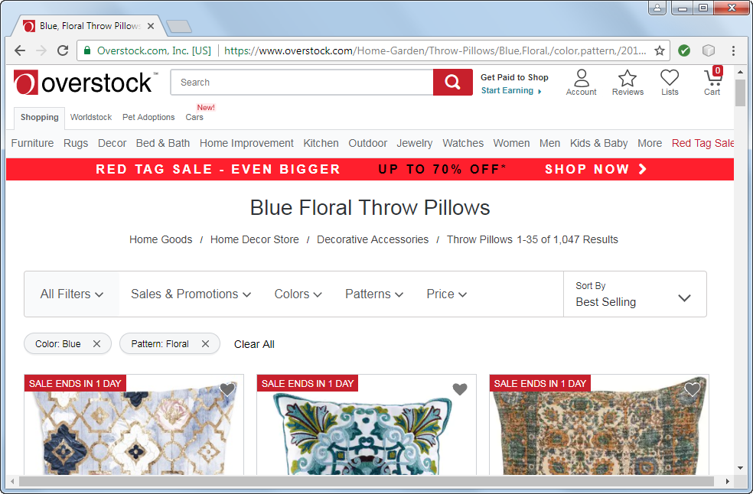
A website that is easy to use (Overstock.com)

Slide 29
How website users use a web page
What website users is usability
To find what they’re looking for as quickly and easily as possible
To get information or do a task as quickly and easily as possible
They scan the page to find what they’re looking for or a link to what they’re looking for, and they don’t like to scroll. If they get frustrated, they leave.
They often click on links and buttons with the hope of finding what they’re looking for, and they frequently click on the Back button when they don’t find it.

Slide 30
Four guidelines for improving usability
Present as much critical information as possible “above the fold”.
Group related items and limit the number of groups on each page.
Include a header that identifies the site and provides a navigation bar and links to utilities.
Use current navigation conventions, like including a logo that goes to your home page when clicked and a cart icon that goes to your shopping cart when clicked.

Slide 31
Guidelines for cross-browser compatibility
Test your web pages on all of the major browsers, including older versions of Internet Explorer that are still in common use.
Use the features of HTML5 and CSS3 that are supported by all modern browsers. But use the workarounds so those features will work in older browsers too.

Slide 32
Accessibility laws that you should be aware of
The Americans with Disabilities Act (ADA).
Sections 504 and 508 of the federal Rehabilitation Act.
Section 255 of the Telecommunications Act of 1996.
Types of disabilities
Visual
Hearing
Motor
Cognitive

Slide 33
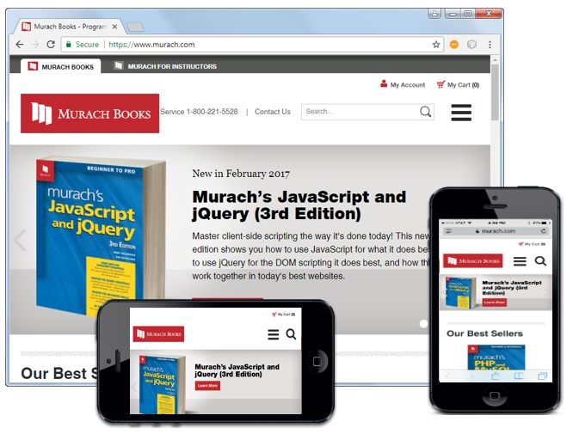
The Murach Books website on different devices

Slide 34
What is Responsive Web Design?
Responsive Web Design refers to websites that are designed to adapt gracefully to the screen size.
Typically, the overall look-and-feel of a website will remain consistent from one screen size to the next.
Media queries, scalable images, and flexible layouts are the backbone of Responsive Web Design.

